Slide 1
Full Stack Web Development
Project Proposal
(20%)
{ Name of Your Proposed App }
{ Your Name }
{ Admin No.}
{ Tutorial Grp}

Slide 2
Declaration of Originality
I am the originator of this work and I have appropriately acknowledged all other original sources used as my references for this work.
I understand that Plagiarism is the act of taking and using the whole or any part of another person’s work, including work generated by AI, and presenting it as my own.
I understand that Plagiarism is an academic offence
and if I am found to have committed or abetted the offence of plagiarism in relation to this submitted work, disciplinary action will be enforced.
Name and Signature of Student:
<<Replace this with Name and Signature of student>>

Slide 3
Declaration on the use of Generative AI tools for assignments
Describe how you have used Generative AI tools such as ChatGPT or Dall.E-2 in your assignment.
Show snapshots of the conversations with the AI tool (i.e., the prompts you used and the response you get from the AI tool).

Slide 4
How do you indicate the reference?
The content generated by AI tools are not retrievable except by the user who generated them, so they are considered non-recoverable sources. Although non-recoverable data or quotations in APA Style papers are usually cited as personal communications, with ChatGPT-generated text there is no person communicating. Quoting text from ChatGPT chat is therefore more like sharing the output of an algorithm, with a reference list entry and the corresponding in-text citation.
According to the official APA Style site, ChatGPT references should be cited as:
E.g. OpenAI. (2023). ChatGPT (Sep 25 version) [Large language model].
https://chat.openai.com/chat
Important Note:
Do not copy answers produced by the AI tool in totality as it is considered as plagiarism.
Do not rely on any information produced by the AI tool blindly. You should always verify the answer with other sources. Do not assume that these answers provided by the AI tool are correct.
To achieve quality outputs from the AI tool, you should provide good prompt that is clear and specific. Be precise and provide context. Avoid asking open-ended questions.

Slide 5
Selected Use Case – Highlight your selected use case below
Case Study Options (The problem statement serves as a starting point; you can use it as is or adapt it based on your users' specific needs.):
Campus Event Management System
Problem Statement: Students often miss out on campus events due to scattered announcements, lack of reminders, and complicated registration processes, leading to low participation and poor event visibility.
Library Book Finder & Reservation System
Problem Statement: Students waste time searching for books in the library without knowing their availability, resulting in frustration and missed opportunities to access learning resources.
Peer-to-Peer Learning / Tutor Finder
Problem Statement: Students often need academic help but struggle to find peers with the right expertise, leading to missed learning opportunities and uneven access to support.
Internship & Job Portal for Students
Problem Statement: Students often struggle to find internships and job opportunities relevant to their courses, as postings are scattered across multiple platforms with no campus-specific matching.

Slide 6
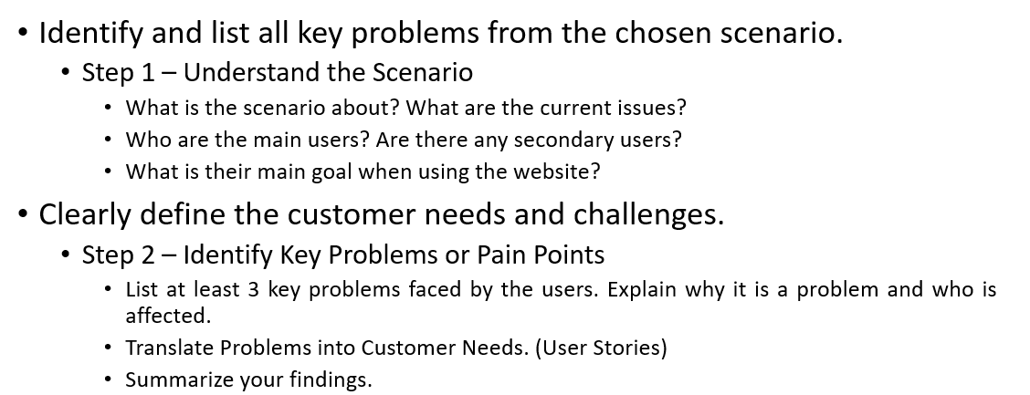
Problem Definition/Customer Needs (4%)

Slide 7
Problem Definition/Customer Needs (4%)
*Feel free to duplicate this slide if necessary

Slide 8
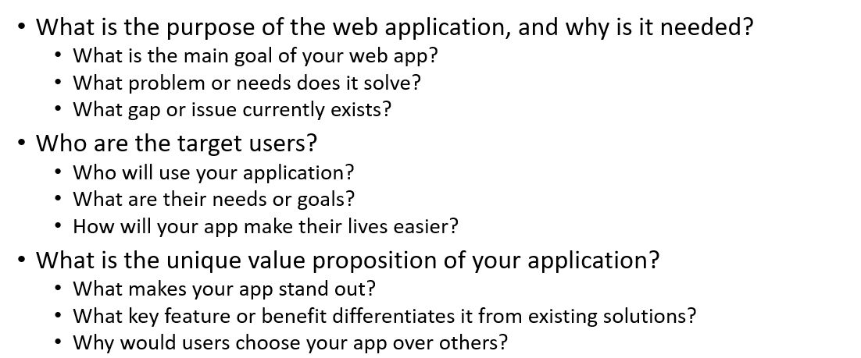
Project Objectives (3%)

Slide 9
Project Objectives (3%)
*Feel free to duplicate this slide if necessary

Slide 10
Proposed Features (3%)
*Feel free to duplicate this slide if necessary
Outline the planned functionalities in detail.
Feature Name | Description / Purpose | User Actions / What It Does | Expected Outcome / Display | Notes / Future Plans
(Example) User Login & Signup | Allow users to create accounts and log in. | Users can sign up with their email and password. | Users see a welcome message or dashboard after logging in. | Will later connect to a database for real login.
Event Listing | …. | …. | … | …

Slide 11
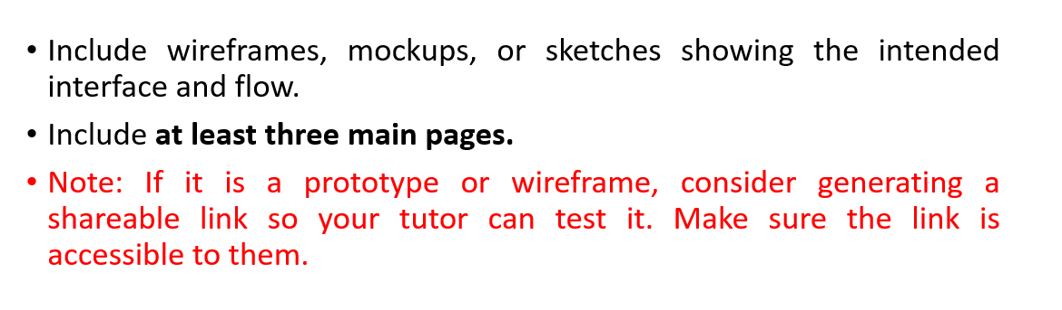
Wireframe (5%)

Slide 12
Wireframe (5%)
*Feel free to duplicate this slide if necessary
(Example) Page 1 (Home Page)

Slide 13
Wireframe (5%)
*Feel free to duplicate this slide if necessary
..

Slide 14
Wireframe (5%)
*Feel free to duplicate this slide if necessary
..

Slide 15
Data Modeling (5%)
Initial identification of entities in your application.
Include at least four key data models and provide sample attributes for each model.
Note: Refer to the sample table in the next slide

Slide 16
Data Modeling - Sample
Table: Event | Description: Represents campus events that users can view or register for. Usage in App: Holds event details that will be displayed on the dashboard and allows users to register for events.
Attribute | Type | Sample Value | Description
eventId | String | E1001 | Unique identifier for each event, used to link with bookings and prevent duplicate records.
title | String | Campus Music Festival | Name of the event, displayed in listings, dashboards, and notifications.
description | String | An evening of live music performances by student bands. | Detailed information about the event, including purpose, schedule, and prerequisites.
date | Date | 2026-02-20T18:00:00Z | Date and time of the event, used for sorting, filtering, and scheduling notifications.
location | String | Main Auditorium | Venue of the event, displayed to users and used for logistics planning.
createdBy | String | U1001 | User ID of the person who created the event, used to track ownership and manage permissions.

Slide 17
Data Modeling
*Feel free to duplicate this slide if necessary
Table: | Description: Usage in App:
Attribute | Type | Sample Value | Description

Slide 18
Data Modeling
*Feel free to duplicate this slide if necessary
Table: | Description: Usage in App:
Attribute | Type | Sample Value | Description

Slide 19
Data Modeling
*Feel free to duplicate this slide if necessary
Table: | Description: Usage in App:
Attribute | Type | Sample Value | Description

Slide 20
Data Modeling
*Feel free to duplicate this slide if necessary
Table: | Description: Usage in App:
Attribute | Type | Sample Value | Description

Slide 21
The End

